Slide 1
NP-Completeness
x
1
x
1
x
2
x
2
x
3
x
3
x
4
x
4
12
22
32
11
13
21
23
31
33
NP-Completeness
Notes:
Graphs

Slide 2
Outline and Reading
P and NP (§13.1)
  Definition of P
  Definition of NP
  Alternate definition of NP
NP-completeness (§13.2)
  Definition of NP-hard and NP-complete
  The Cook-Levin Theorem
NP-Completeness

Slide 3
Running Time Revisited
Input size, n
  To be exact, let n denote the number of bits in a nonunary encoding of the input
All the polynomial-time algorithms studied so far in this course run in polynomial time using this definition of input size.
  Exception: any pseudo-polynomial time algorithm
849
PVD
1843
ORD
SFO
142
802
LGA
337
1743
HNL
1387
2555
1099
LAX
1233
DFW
1120
MIA
NP-Completeness

Slide 4

Dealing with Hard Problems
What to do when we find a problem that looks hard…
I couldn’t find a polynomial-time algorithm;
I guess I’m too dumb.
NP-Completeness
(cartoon inspired by [Garey-Johnson, 79])

Slide 5

Dealing with Hard Problems
Sometimes we can prove a strong lower bound… (but not usually)
I couldn’t find a polynomial-time algorithm,
because no such algorithm exists!
NP-Completeness
(cartoon inspired by [Garey-Johnson, 79])

Slide 6





Dealing with Hard Problems
NP-completeness let’s us show collectively that a problem is hard.
I couldn’t find a polynomial-time algorithm,
but neither could all these other smart people.
NP-Completeness
(cartoon inspired by [Garey-Johnson, 79])

Slide 7

Polynomial-Time
Decision Problems
To simplify the notion of “hardness,” we will focus on the following:
  Polynomial-time as the cut-off for efficiency
  Decision problems: output is 1 or 0 (“yes” or “no”)
    Examples:
    Does a given graph G have an Euler tour?
    Does a text T contain a pattern P?
    Does an instance of 0/1 Knapsack have a solution with benefit at least K?
    Does a graph G have an MST with weight at most K?
NP-Completeness

Slide 8

Problems and Languages
A language L is a set of strings defined over some alphabet Σ
Every decision algorithm A defines a language L
  L is the set consisting of every string x such that A outputs “yes” on input x.
  We say “A accepts x’’ in this case
    Example:
    If A determines whether or not a given graph G has an Euler tour, then the language L for A is all graphs with Euler tours.
NP-Completeness

Slide 9

The Complexity Class P
A complexity class is a collection of languages
P is the complexity class consisting of all languages that are accepted by polynomial-time algorithms
For each language L in P there is a polynomial-time decision algorithm A for L.
  If n=|x|, for x in L, then A runs in p(n) time on input x.
  The function p(n) is some polynomial
NP-Completeness

Slide 10

The Complexity Class NP
We say that an algorithm is non-deterministic if it uses the following operation:
  Choose(b): chooses a bit b
  Can be used to choose an entire string y (with |y| choices)
We say that a non-deterministic algorithm A accepts a string x if there exists some sequence of choose operations that causes A to output “yes” on input x.
NP is the complexity class consisting of all languages accepted by polynomial-time non-deterministic algorithms.
NP-Completeness

Slide 11
NP example
Problem: Decide if a graph has an MST of weight K
Algorithm:
  Non-deterministically choose a set T of n-1 edges
  Test that T forms a spanning tree
  Test that T has weight at most K
Analysis: Testing takes O(n+m) time, so this algorithm runs in polynomial time.
NP-Completeness

Slide 12
The Complexity Class NP Alternate Definition
We say that an algorithm B verfies the acceptance of a language L if and only if, for any x in L, there exists a certificate y such that B outputs “yes” on input (x,y).
NP is the complexity class consisting of all languages verified by polynomial-time algorithms.
We know: P is a subset of NP.
Major open question: P=NP?
Most researchers believe that P and NP are different.
NP-Completeness

Slide 13
NP example (2)
Problem: Decide if a graph has an MST of weight K
Verification Algorithm:
  Use as a certificate, y, a set T of n-1 edges
  Test that T forms a spanning tree
  Test that T has weight at most K
Analysis: Verification takes O(n+m) time, so this algorithm runs in polynomial time.
NP-Completeness

Slide 14
Equivalence of the
Two Definitions
Suppose A is a non-deterministic algorithm
  Let y be a certificate consisting of all the outcomes of the choose steps that A uses
  We can create a verification algorithm that uses y instead of A’s choose steps
  If A accepts on x, then there is a certificate y that allows us to verify this (namely, the choose steps A made)
  If A runs in polynomial-time, so does this verification algorithm
Suppose B is a verification algorithm
  Non-deterministically choose a certificate y
  Run B on y
  If B runs in polynomial-time, so does this non-deterministic algorithm
NP-Completeness

Slide 15
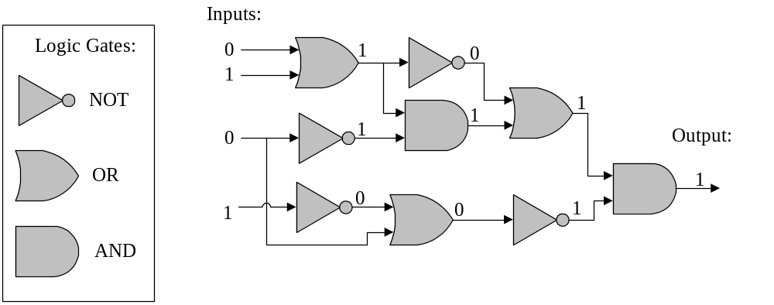
An Interesting Problem
A Boolean circuit is a circuit of AND, OR, and NOT gates; the CIRCUIT-SAT problem is to determine if there is an assignment of 0’s and 1’s to a circuit’s inputs so that the circuit outputs 1.
NP-Completeness

Slide 16
CIRCUIT-SAT is in NP
Non-deterministically choose a set of inputs and the outcome of every gate, then test each gate’s I/O.
NP-Completeness

Slide 17
NP-Completeness
A problem (language) L is NP-hard if every problem in NP can be reduced to L in polynomial time.
That is, for each language M in NP, we can take an input x for M, transform it in polynomial time to an input x’ for L such that x is in M if and only if x’ is in L.
L is NP-complete if it’s in NP and is NP-hard.
NP
poly-time
L
NP-Completeness

Slide 18
Cook-Levin Theorem
CIRCUIT-SAT is NP-complete.
  We already showed it is in NP.
To prove it is NP-hard, we have to show that every language in NP can be reduced to it.
  Let M be in NP, and let x be an input for M.
  Let y be a certificate that allows us to verify membership in M in polynomial time, p(n), by some algorithm D.
  Let S be a circuit of size at most O(p(n)²) that simulates a computer (details omitted…)
NP
M
poly-time
CIRCUIT-SAT
NP-Completeness

Slide 19
Cook-Levin Proof
We can build a circuit that simulates the verification of x’s membership in M using y.
  Let W be the working storage for D (including registers, such as program counter); let D be given in RAM “machine code.”
  Simulate p(n) steps of D by replicating circuit S for each step of D. Only input: y.
  Circuit is satisfiable if and only if x is accepted by D with some certificate y
  Total size is still polynomial: O(p(n)³).
D
D
D
< p(n)
W
W
W
cells
S
S
S
Output
0/1
from D
Inputs
y
y
y
n
x
x
x
p(n)
NP-Completeness
steps

Slide 20
Some Thoughts about P and NP
NP
NP-complete
problems live here
P
CIRCUIT-SAT
Belief: P is a proper subset of NP.
Implication: the NP-complete problems are the hardest in NP.
Why: Because if we could solve an NP-complete problem in polynomial time, we could solve every problem in NP in polynomial time.
That is, if an NP-complete problem is solvable in polynomial time, then P=NP.
Since so many people have attempted without success to find polynomial-time solutions to NP-complete problems, showing your problem is NP-complete is equivalent to showing that a lot of smart people have worked on your problem and found no polynomial-time algorithm.
NP-Completeness

